Slide 1
American Car License Plate Recognition
EECE7398 Advances in Deep Learning – Final Presentation
Zehua Liu
Xu Liang
Hao Lei

Slide 2
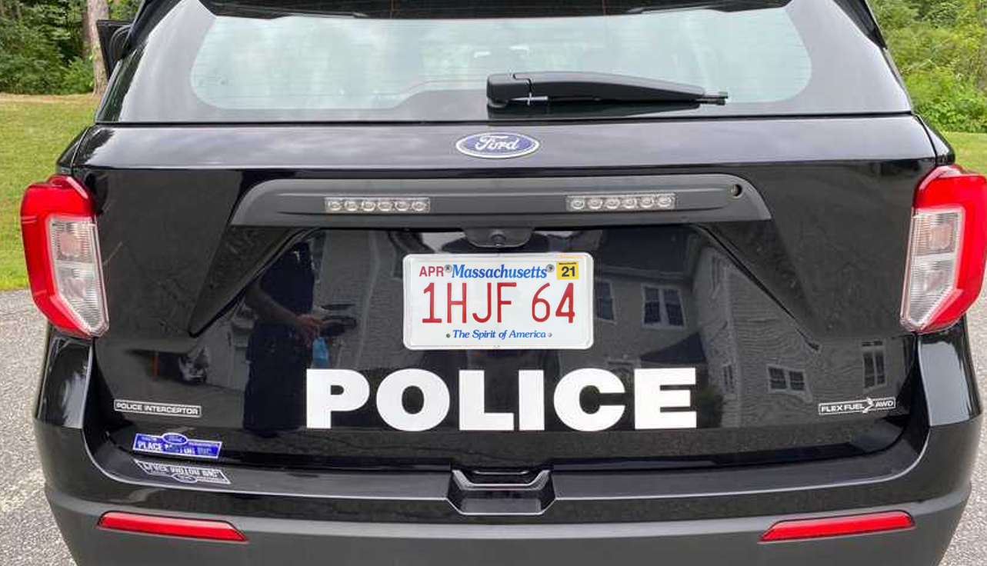
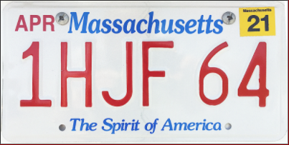


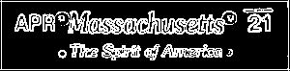
Overview
Due to lack of dataset, split the whole process into small problems and use simple-structure nets to conquer each
Rectangle
detection
candidates
Size/Shape Filter
PVN
Plate Validation Net
Extract top and bottom parts
- Grayscale
- Edge detection - Binarization
1 H J F 6 4
CRN
Char Recognition Net
Character segmentation
Serial extraction
RGB/HSV Info
MA
SRN
State Recognition Net

Slide 3
Road Map
Dataset Manufacturing
Rectangle Detection & Plate Validation
State Recognition & Serial Extraction
Character Segmentation & Recognition
Future Work

Slide 4
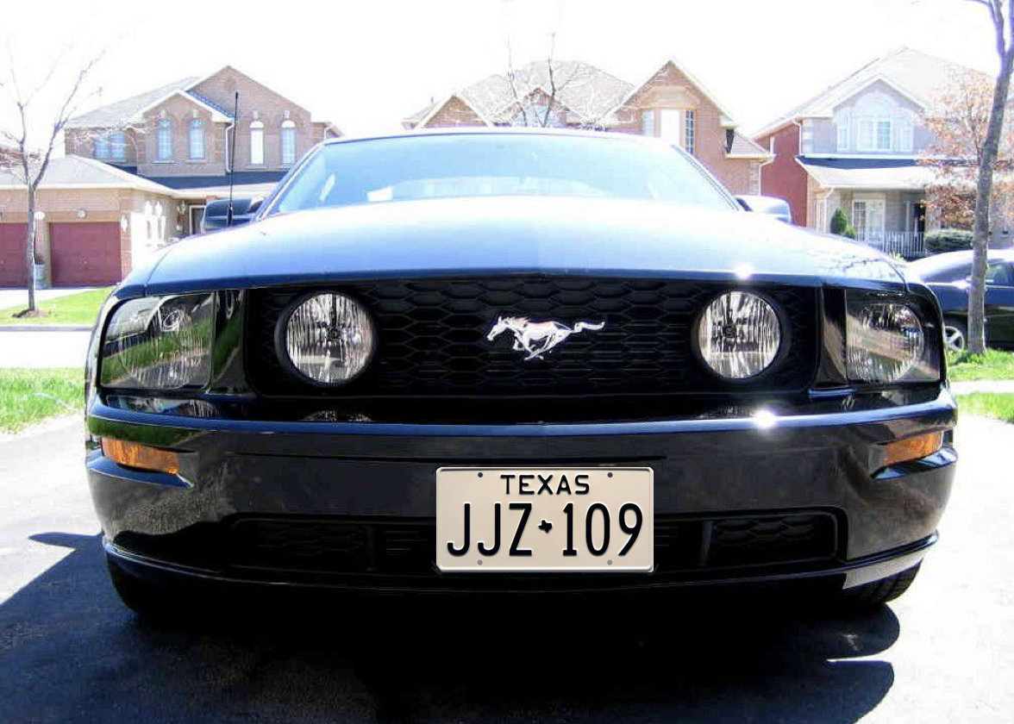
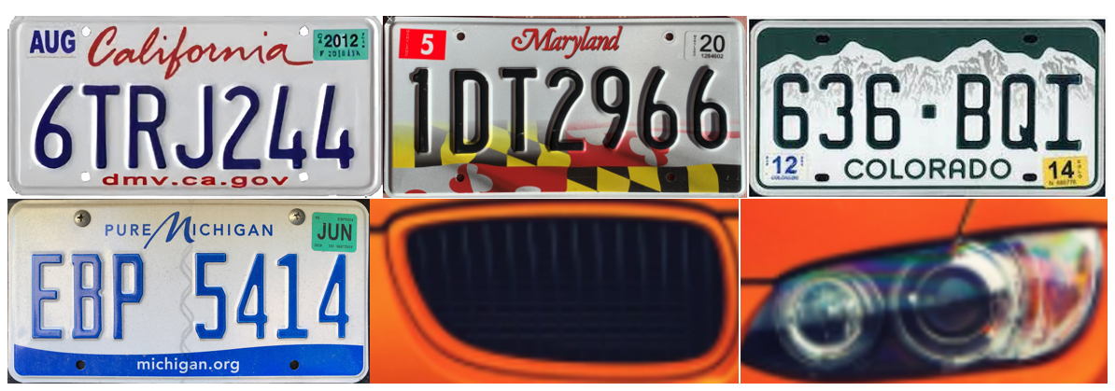
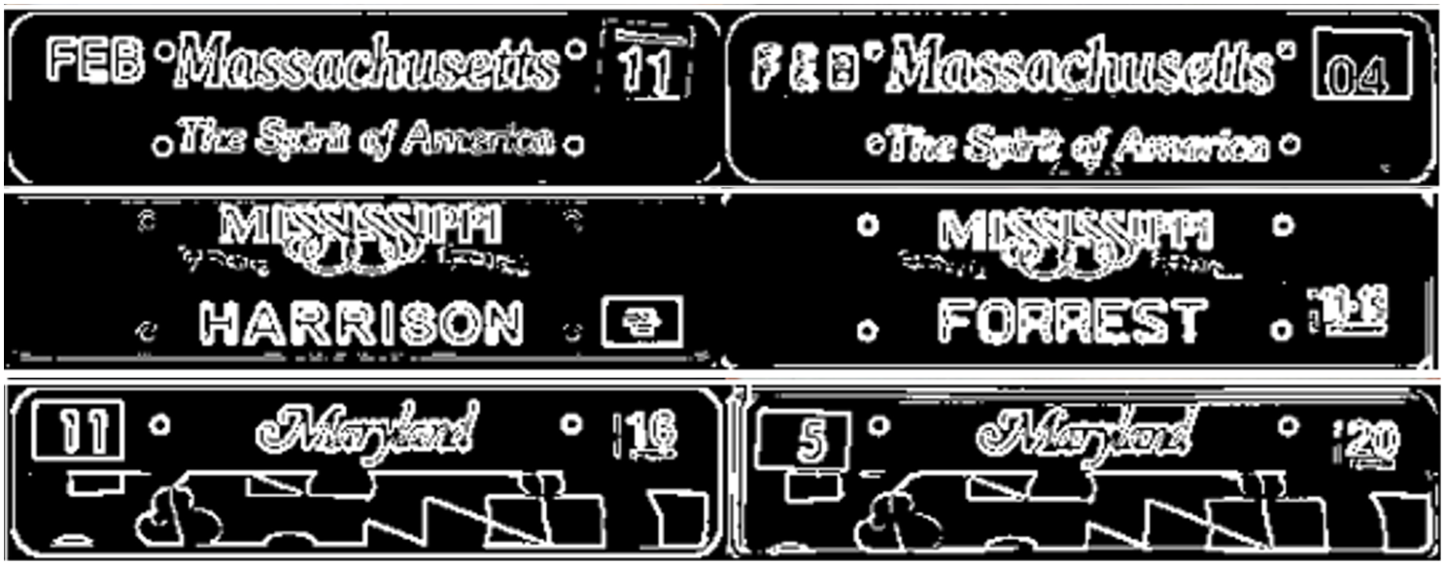
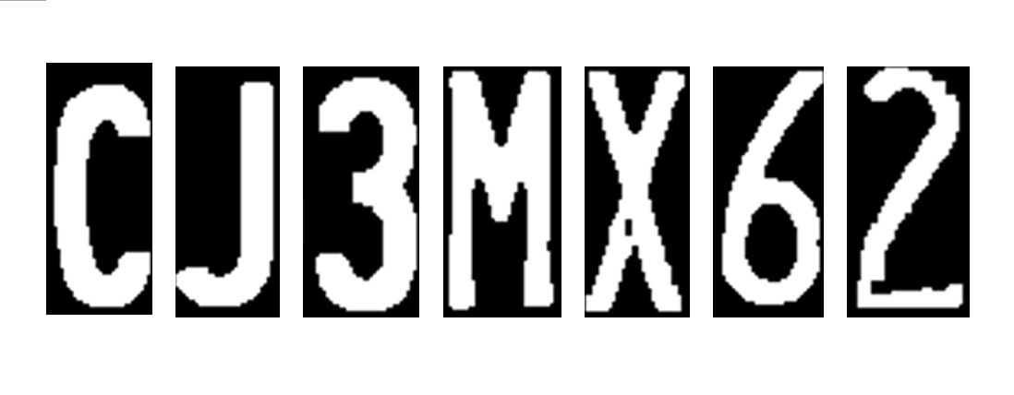
Dataset Manufacturing
Only used for overall test
Derive
PVN
Plate Validation Net
SRN
State Recognition Net
CRN
Char Recognition Net

Slide 5
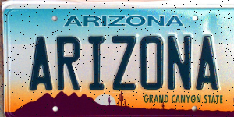
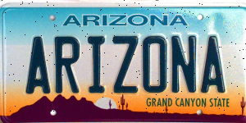

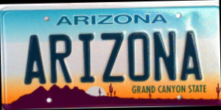
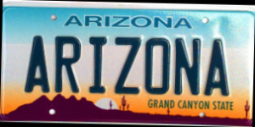
Dataset Manufacturing
No perfect clarity?
No perfect angle?
Add random noise
Add rotations

Slide 6
Road Map
Dataset Manufacturing
Rectangle Detection & Plate Validation
State Recognition & Serial Extraction
Character Segmentation & Recognition
Future Work

Slide 7

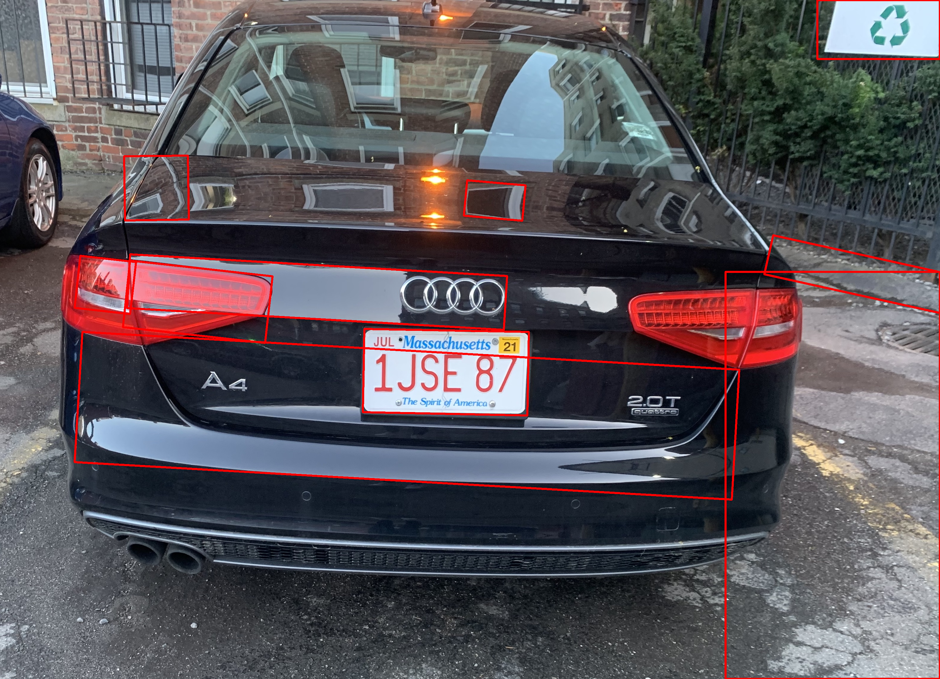
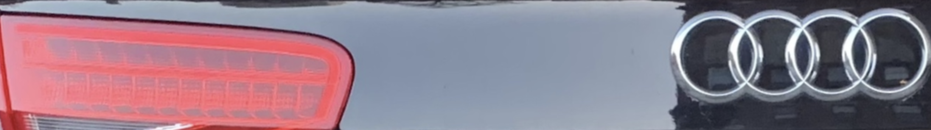
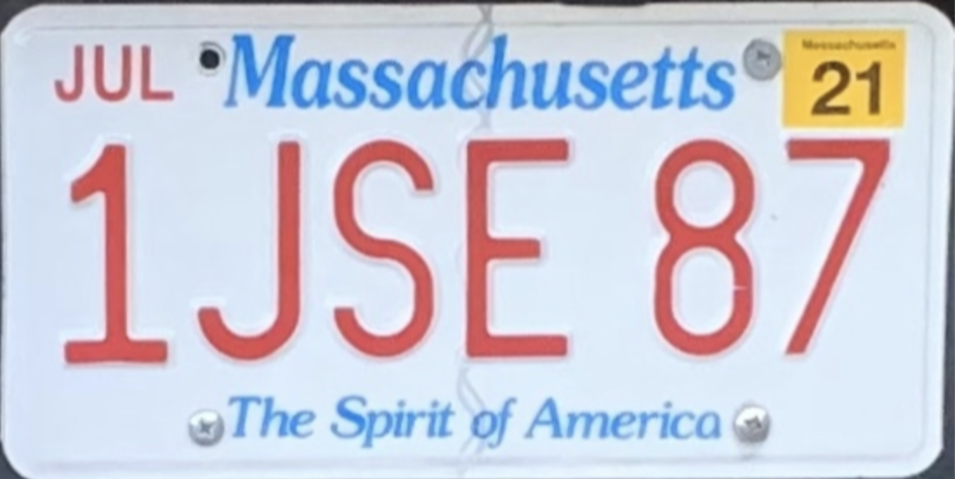
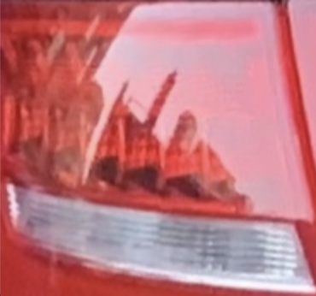
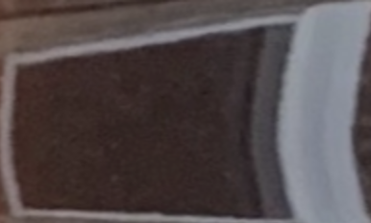
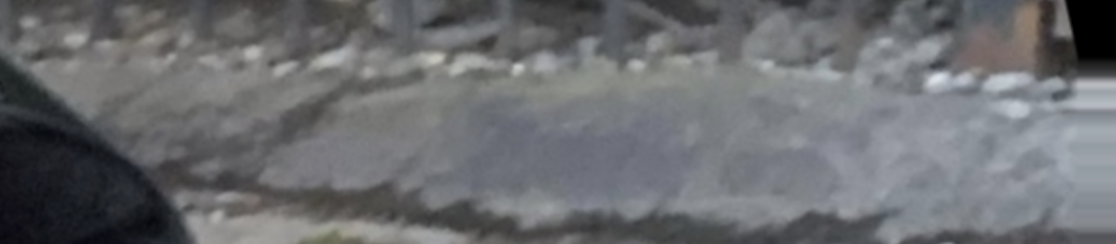
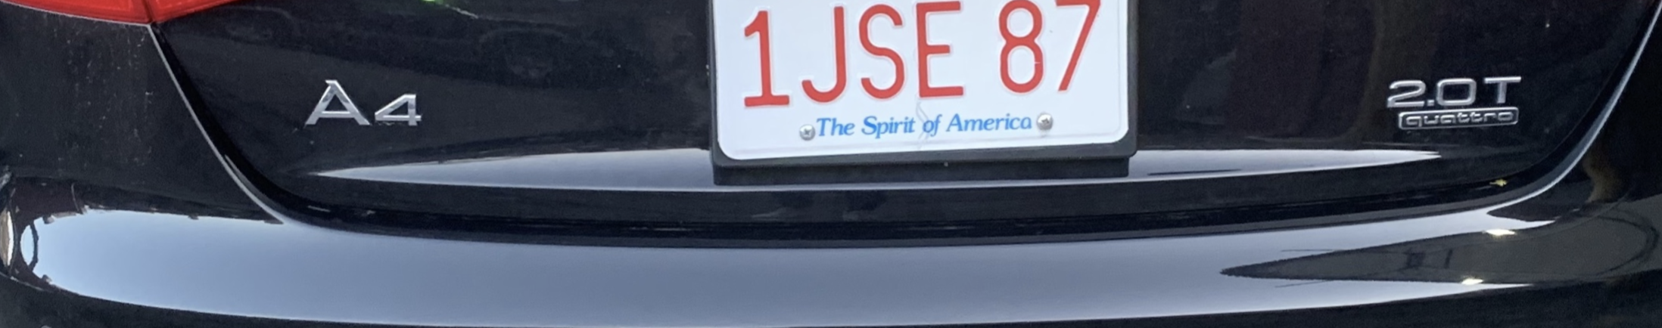
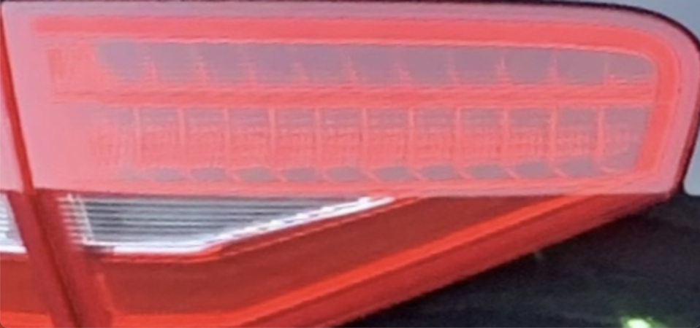
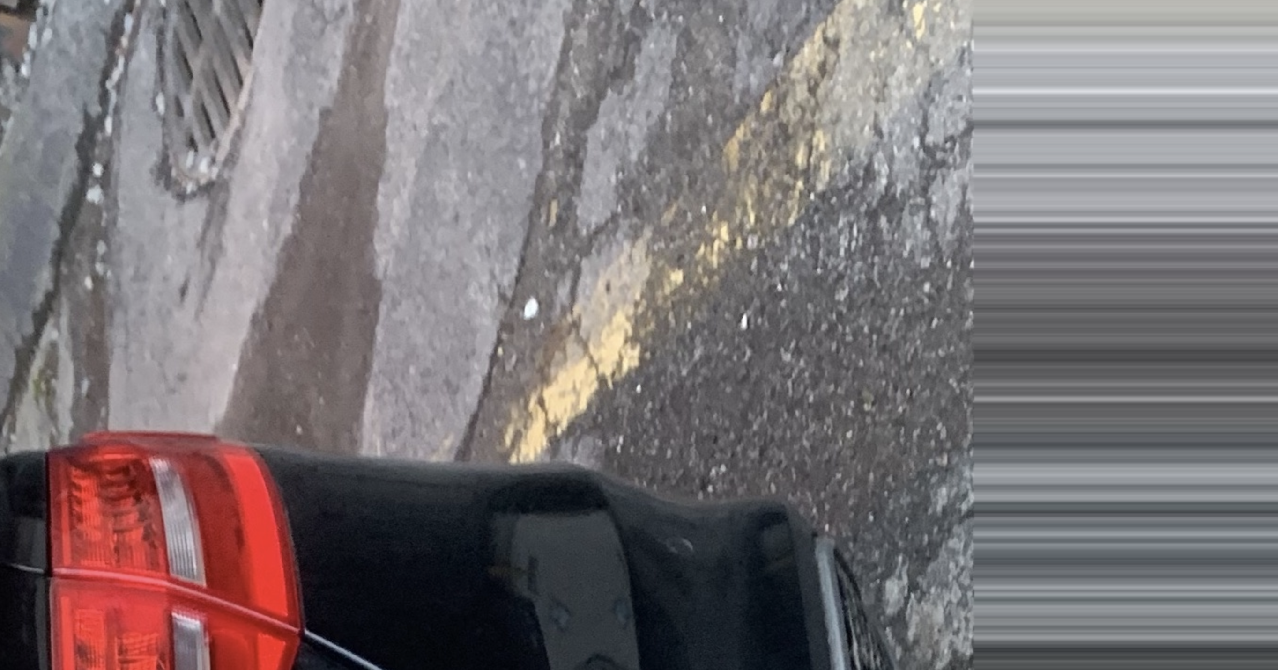
Rectangle Detection and Plate Validation
Find minimum enclosing rectangles with the rational size
Straighten and crop the rectangle images

Slide 8
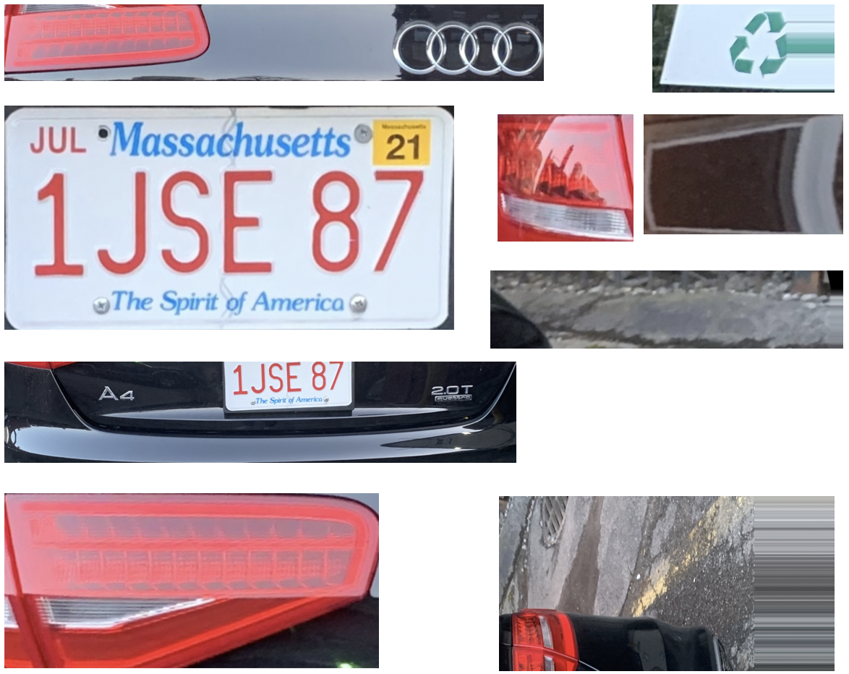
Rectangle Detection and Plate Validation
Cropped rectangle images
The Image verified as True by PVN
PVN
Plate Validation Net

Slide 9
Road Map
Dataset Manufacturing
Rectangle Detection & Plate Validation
State Recognition & Serial Extraction
Character Segmentation & Recognition
Future Work

Slide 10
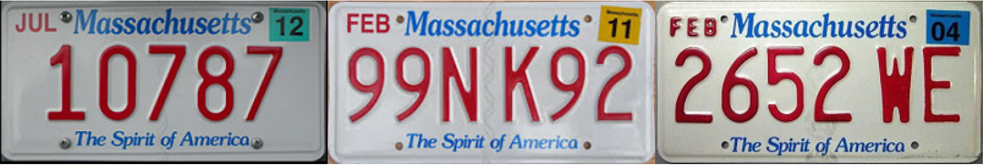
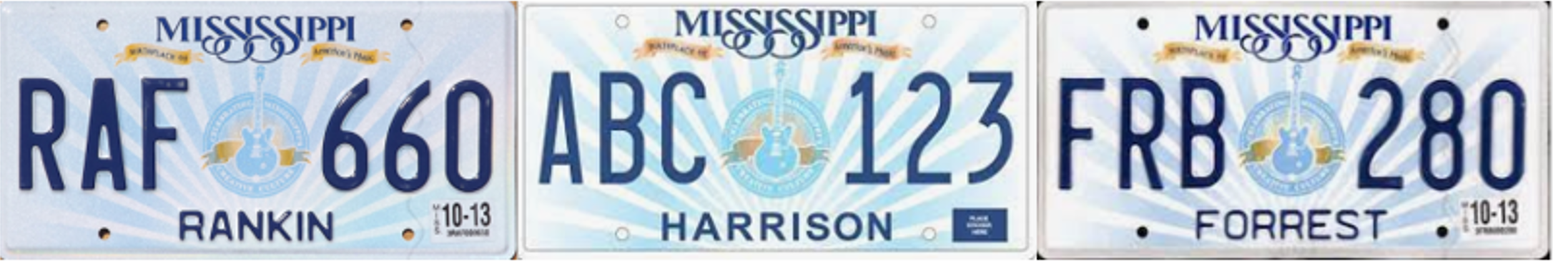
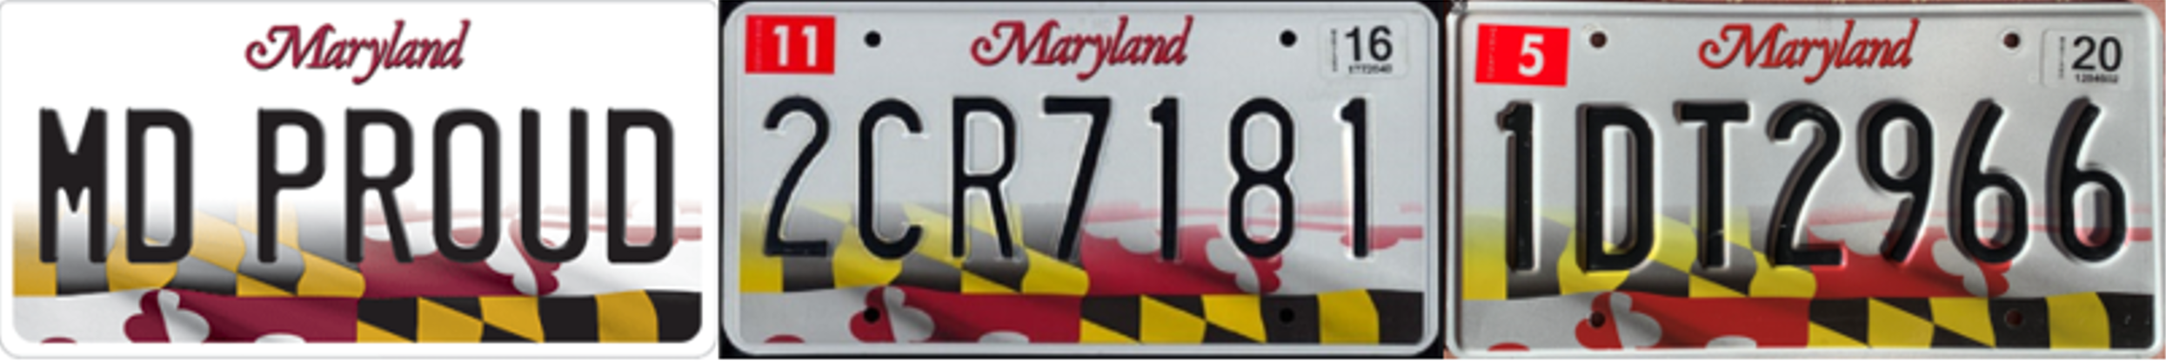
State Recognition and Serial Extraction
Three important properties
Format & Pattern are stable
Serial colors are consistent
Serial colors are different from the background

Slide 11
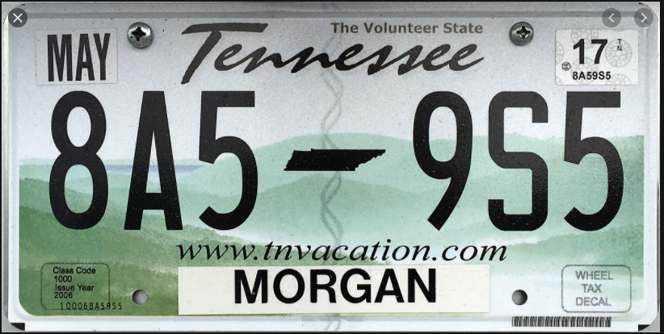
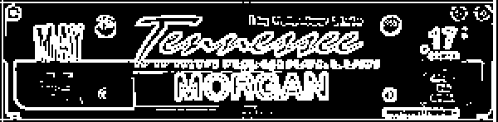
State Recognition and Serial Extraction
State features area
Edge detection & binarization
> 127 ➔ 255
<= 127 ➔ 0
SRN
State Recognition Net
Result: TN
Feature image

Slide 12

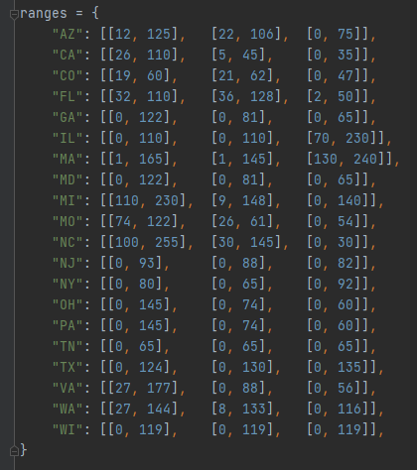
State Recognition and Serial Extraction
Serial area
TN: [[0, 65], [0, 65], [0, 65]]
Look up to
Result: TN
State-color range table

Slide 13
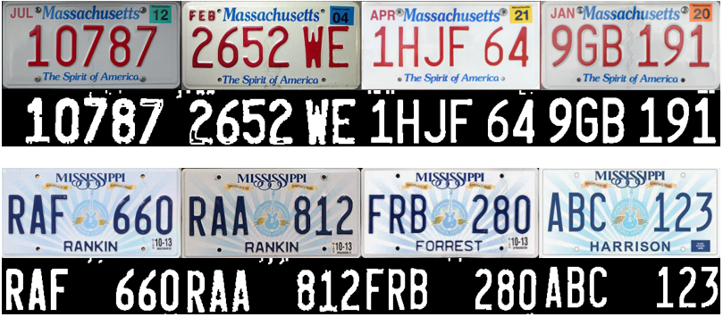
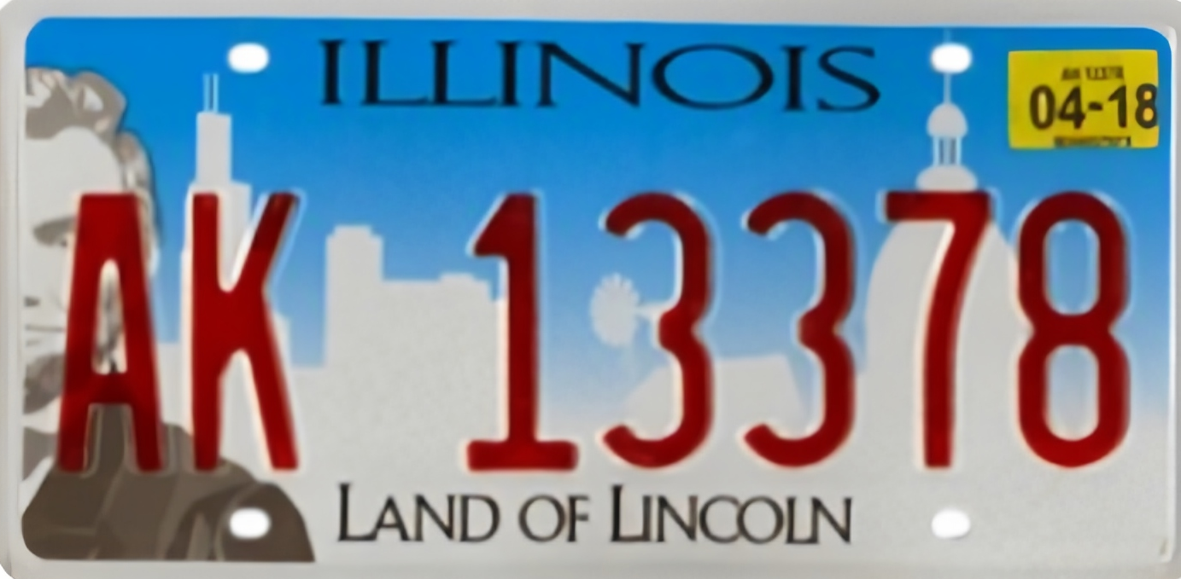

State Recognition and Serial Extraction
New and old license plates?
Different illumination?
Properly widened RGB range
Too-wide RGB range

Slide 14
Road Map
Dataset Manufacturing
Rectangle Detection & Plate Validation
State Recognition and Serial Extraction
Character Segmentation & Recognition
Future Work

Slide 15

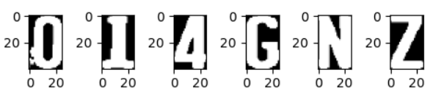
Character Segmentation and Recognition
Erosion and Dilation Processing
Find the bounding rectangle based on the rational size of the character
Crop the rectangle image
Normalize the size of each character image

Slide 16
Character Segmentation and Recognition

Slide 17
Road Map
Dataset Manufacturing
Rectangle Detection & Plate Validation
State Recognition & Serial Extraction
Character Segmentation & Recognition
Future Work

Slide 18
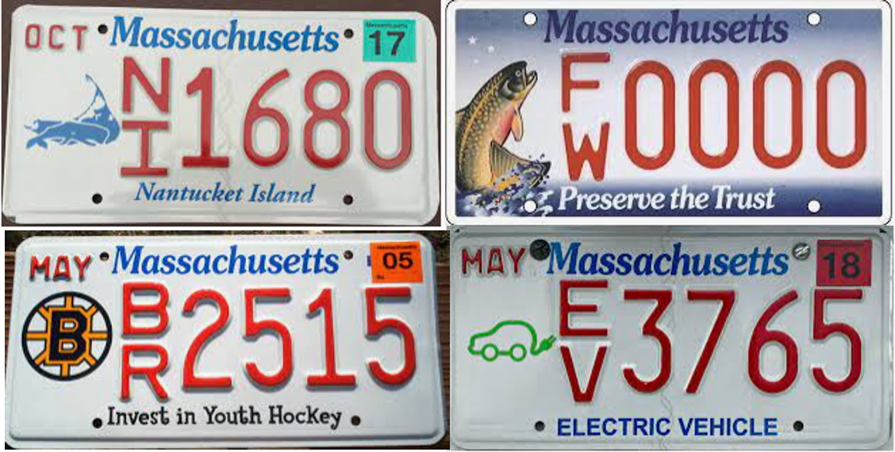
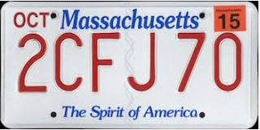
Future Work
1. Improvement of universality
- More states (currently we only deal with the top-20 states with the most population)
- More patterns (people may have various customized plates and different versions)

Slide 19
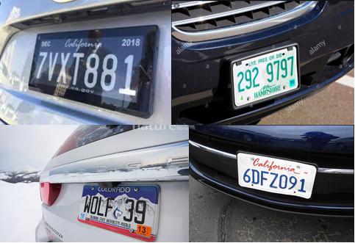
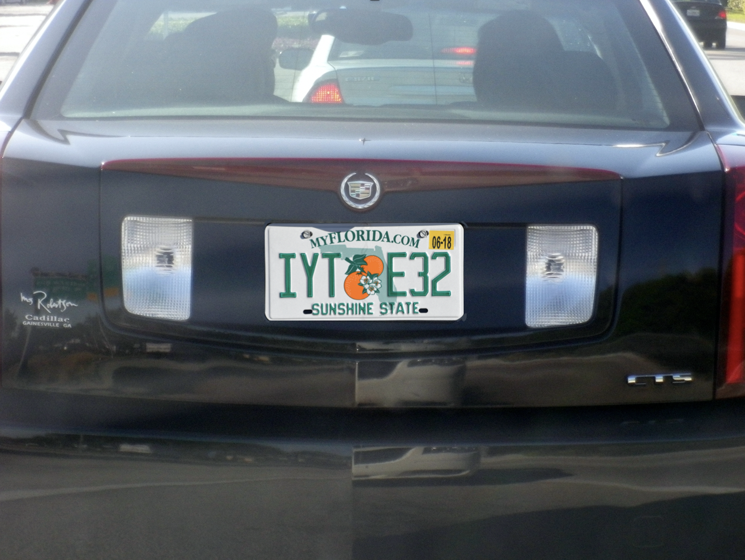
Future Work
2. Various conditions
Currently the condition we assume/restrict is that the recognition happens at the entrance/exit of a parking lot.
- Not perfect angle
- Extreme weather conditions

Slide 20
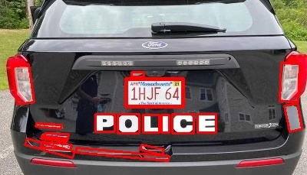
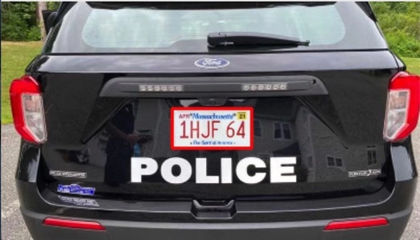
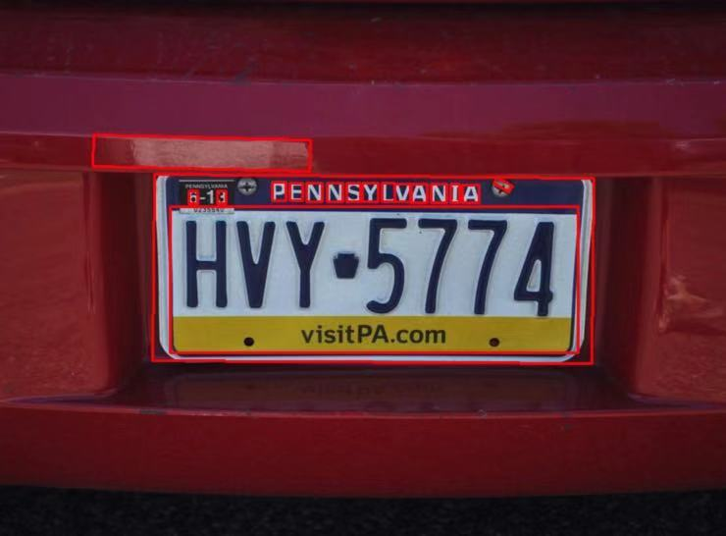
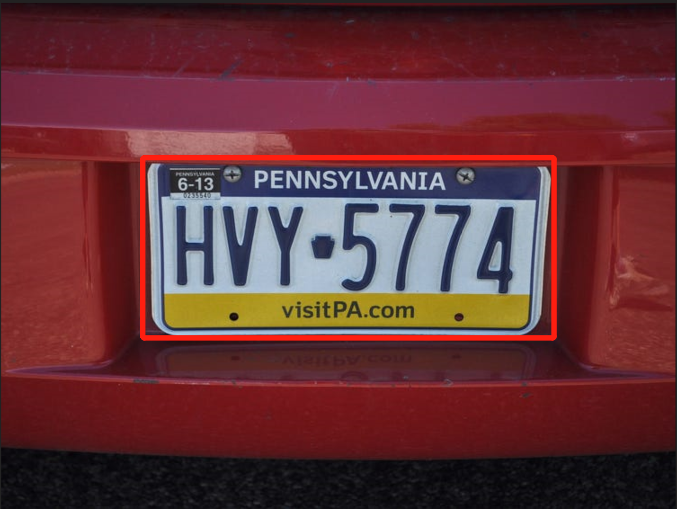
Future Work
3. More robust plate detection
We may consider using YOLO Net in the future to directly detect plate in an image

